Slide 1
SECURE DATE HIDING IN IMAGES USING STEGANOGRAPHY
Presented By: TharunKumarReddy Dhanipati
Student Name : TharunKumarReddy Dhanipati
College Name & Department : Prabhat Institute of Computer Science & MCA

Slide 2
OUTLINE
Problem Statement
Technology used
Wow factor
End users
Result
Conclusion
Git-hub Link
Future scope

Slide 3
Problem Statement
In today’s digital world , securing confidential data during transmission is crucial. Traditional encryption methods make data transmission noticeable and prone to attacks.
The challenge is to develop a secure method that can hide sensitive data in image’s appearance, making the transmission inconspicuous.
The embedded secret message should not be noticeable in the cover medium to avoid suspicion.

Slide 4
Technology used
The Technology used in the project are:
Programming Language: Python
Steganography Techniques: Least Significant Bit method
Encryption Algorithms: AES (Advanced Encryption Standard) for additional security
Library Used: OpenCV, OpenStego, Cryptography
Operating Systems: Windows11
Image format: .jpg

Slide 5
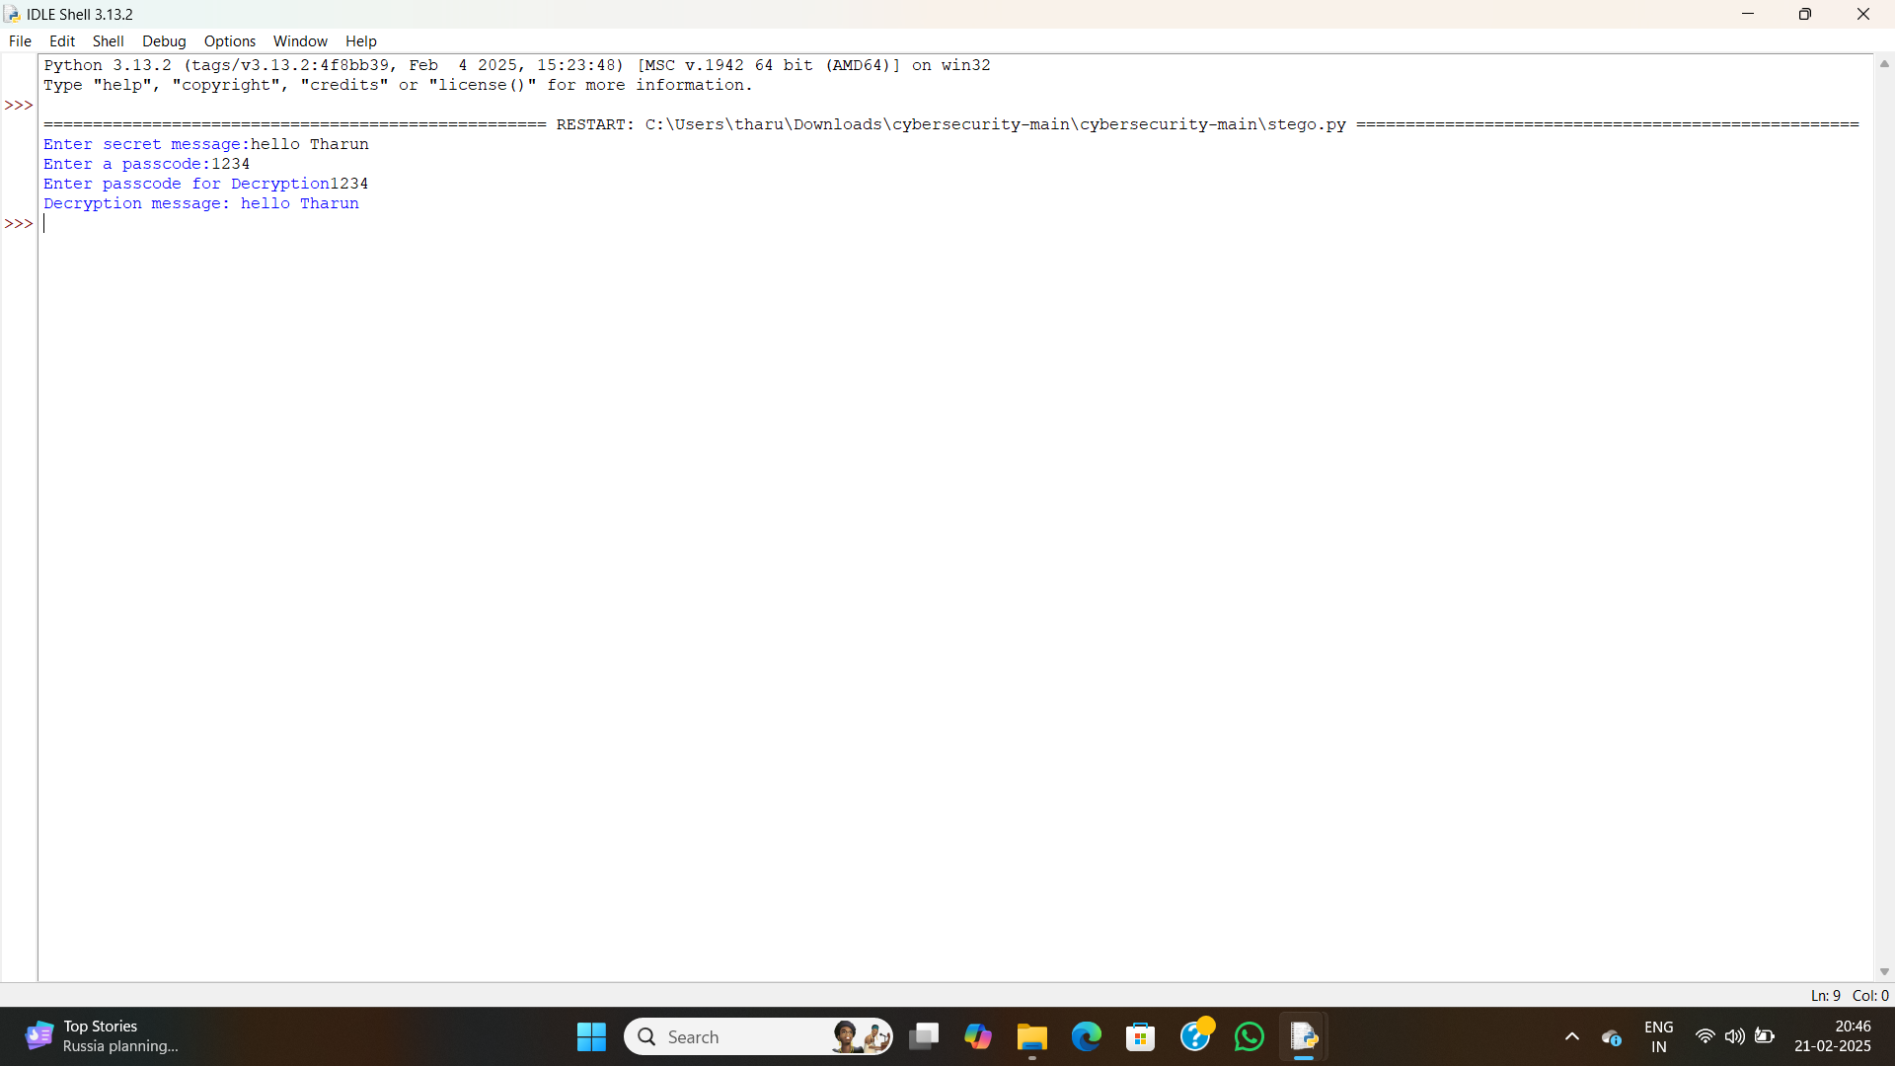
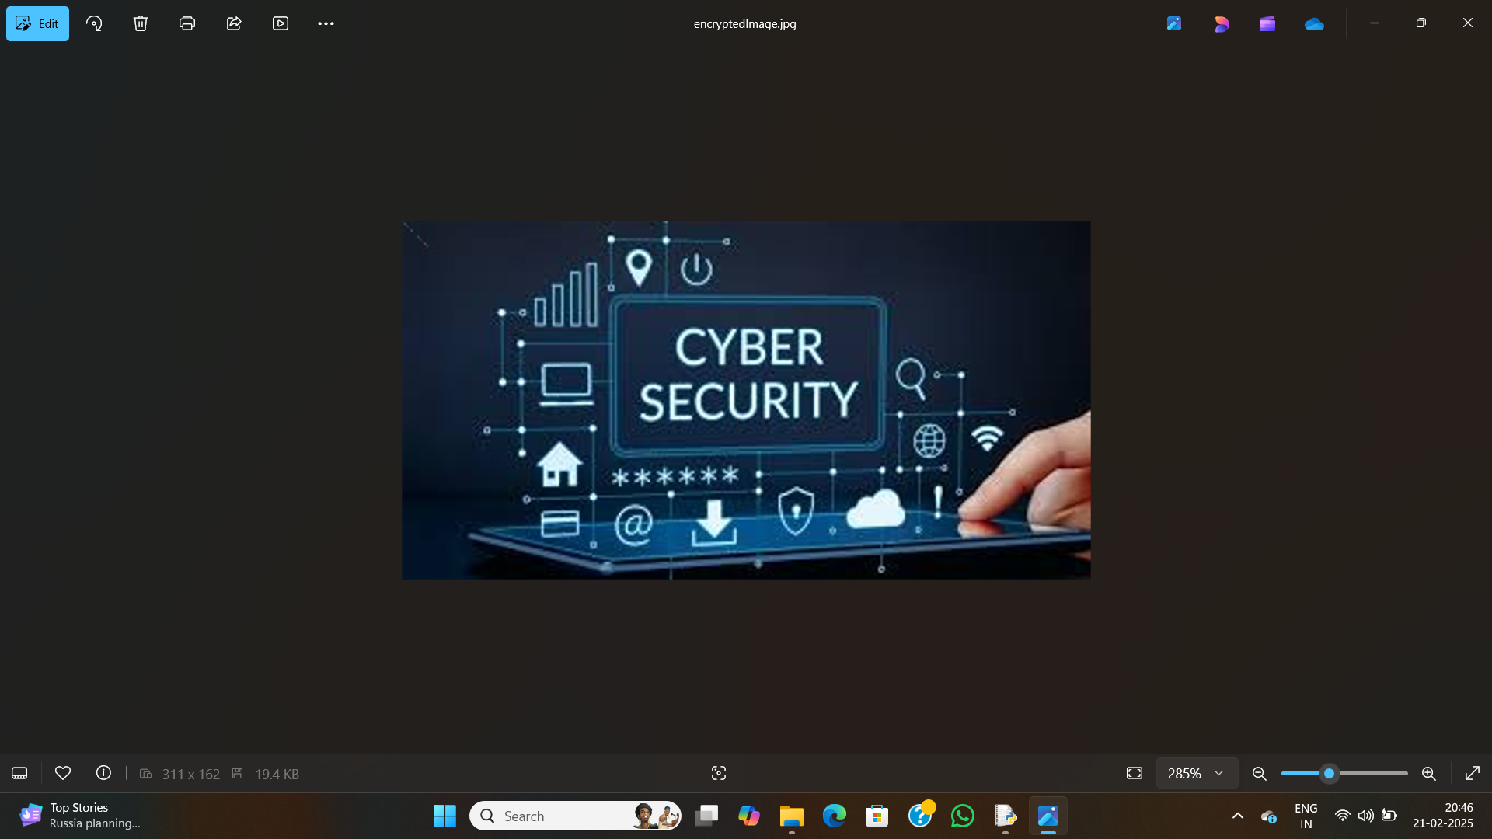
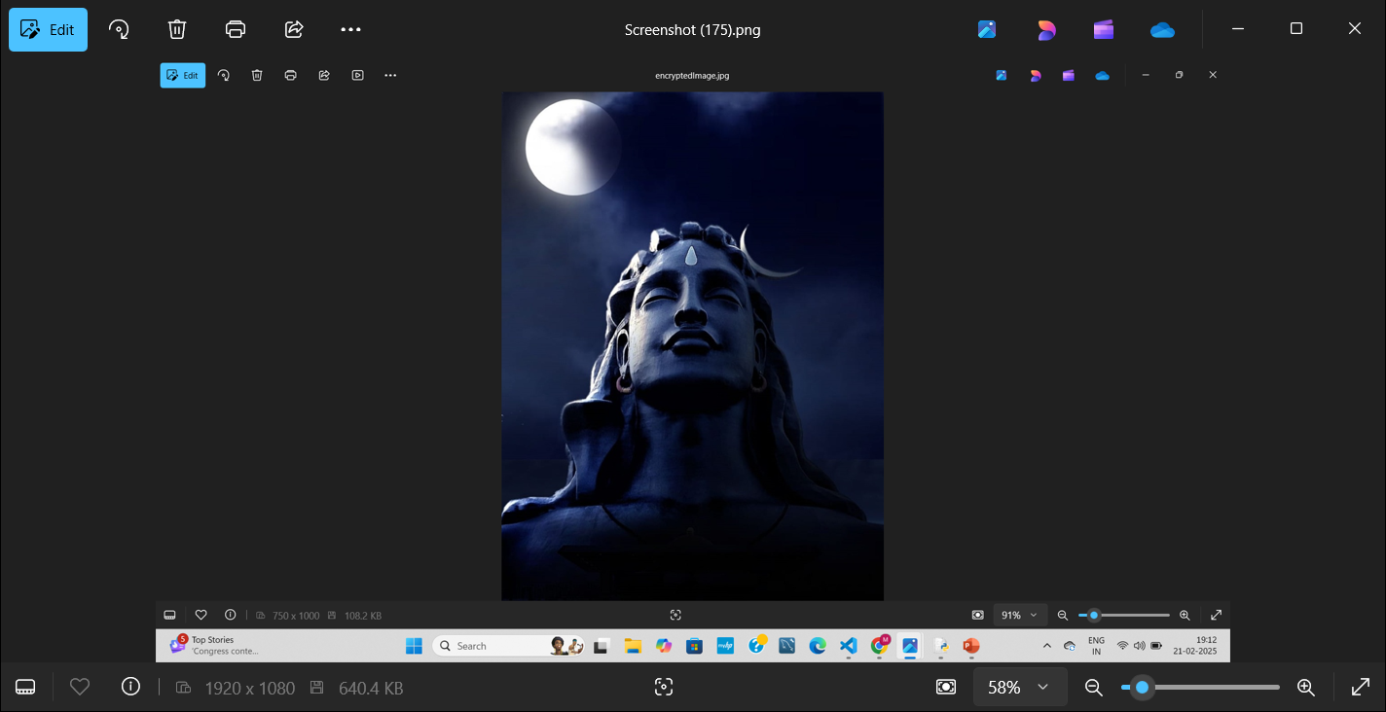
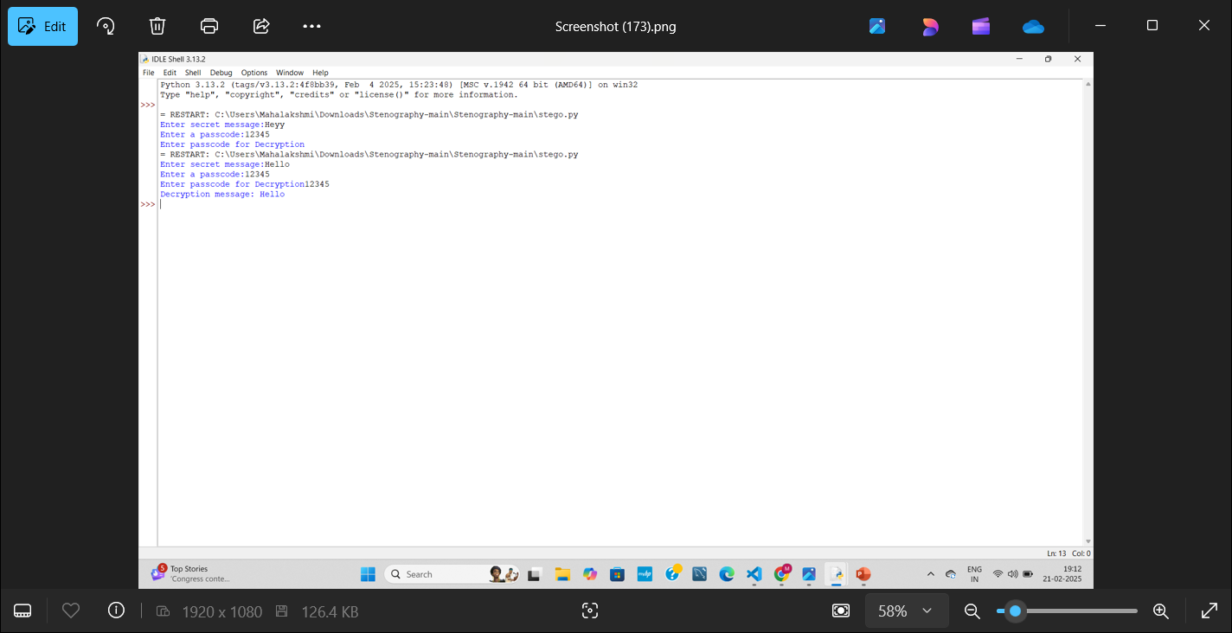
Wow factors
Invisible Data Transmission: The hidden data is imperceptible to human eye.
Dual Security : Combination of encryption and steganography enhances protection.
Low Detection Risk : Unlike encryption , steganography does not draw attention.
Easy Embedding and Extraction : A simple and efficient process for encoding and decoding data

Slide 6
End users
Government agencies for secure communication.
Journalists and whistleblowers for confidential information exchange.
Business for securing trade secrets and sensitive data.
General users looking for a private method of communication.

Slide 7
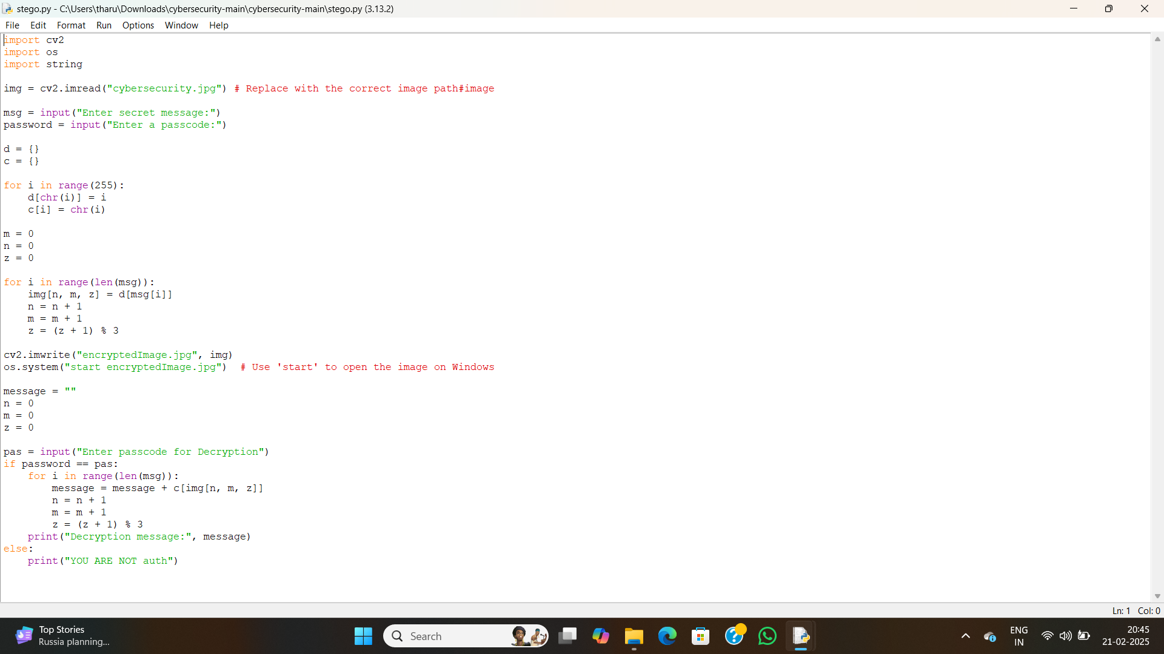
Results

Slide 8
output

Slide 9
image

Slide 10
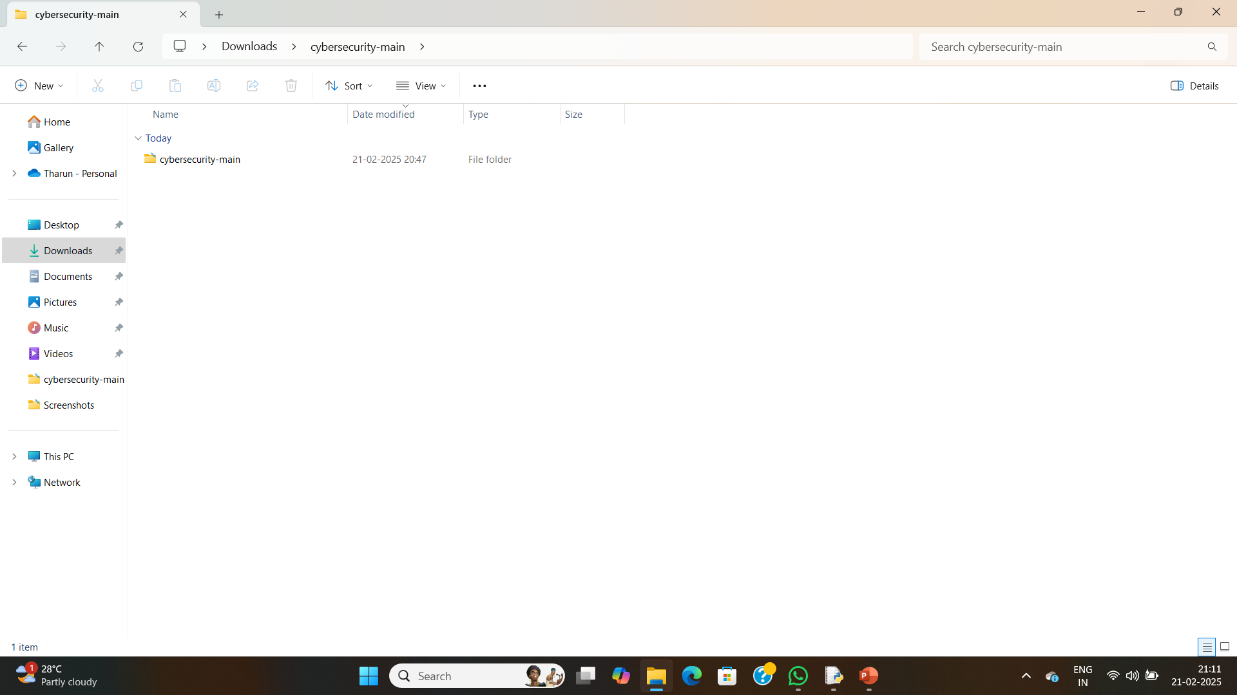
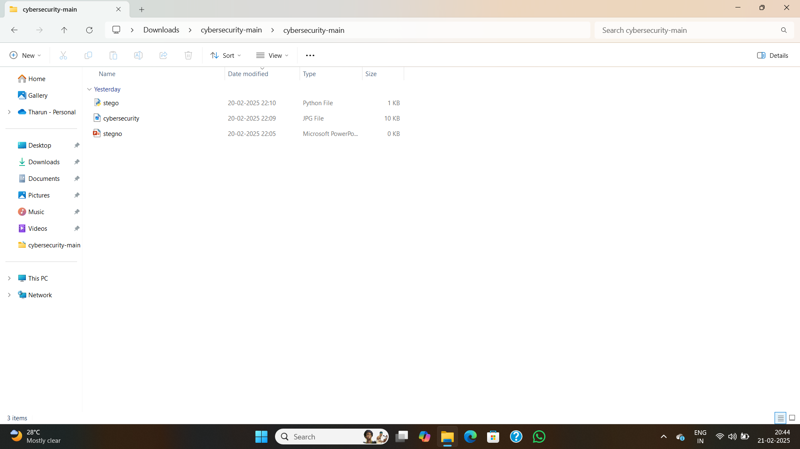
Files

Slide 11
Conclusion
This project demonstrates an effective way of securely hiding data within images steganography. While minimizing detection risks. Future improvements could involve adaptive techniques that further enhance security.

Slide 12
GitHub Link
https://github.com/Tharun1466/cybersecurity.git

Slide 13
Future scope(optional)
Enhancing security with advanced encryption techniques.
Extending to video and audio steganography.
Developing a mobile application for real-time secure communication.

Slide 14
THANK YOU

